Slide 1


Documents Q&A Assistant: Integrating Chatbot Technology for Efficient Information Retrieval using RAG
Group Members :
Atharva (202318004)
Sobhan (202318040)
Kushagra (202318048)

Slide 2
Objective:
The objective of the project is to create a Document Q&A Assistant that efficiently retrieves information from files. This involves:
Processing documents to extract text content.
Implementing a question answering system to provide accurate responses to user queries.
Integrating a chatbot component for interactive user engagement.
Developing a user-friendly interface.
Ensuring scalability, performance, and integration with Cassandra for backend storage.
Evaluating system accuracy and user satisfaction for iterative improvements.

Slide 3
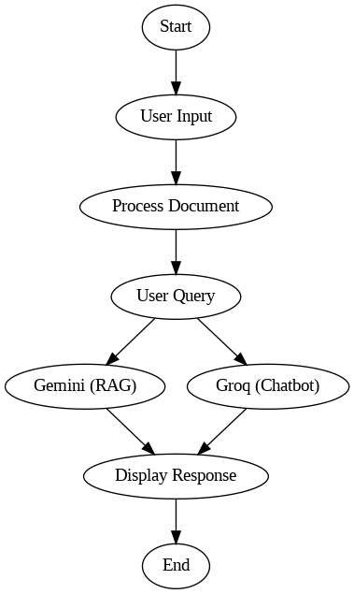
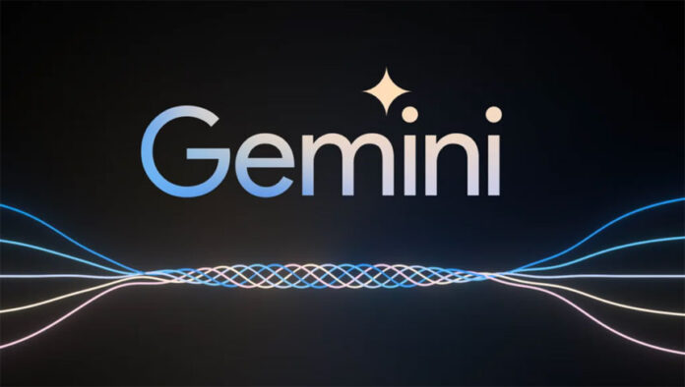

FLOWCHART

Slide 4
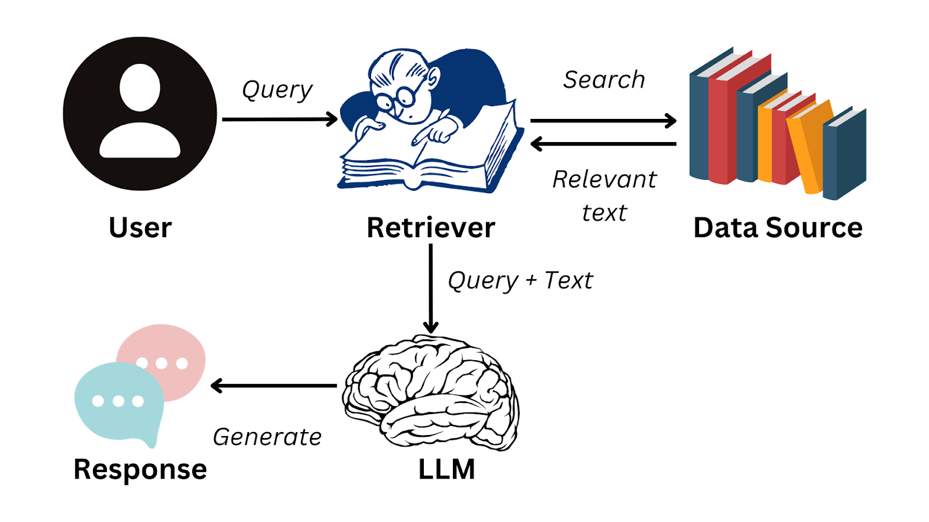
FLOWCHART
Ref : https://www.datacamp.com/blog/what-is-retrieval-augmented-generation-rag

Slide 5
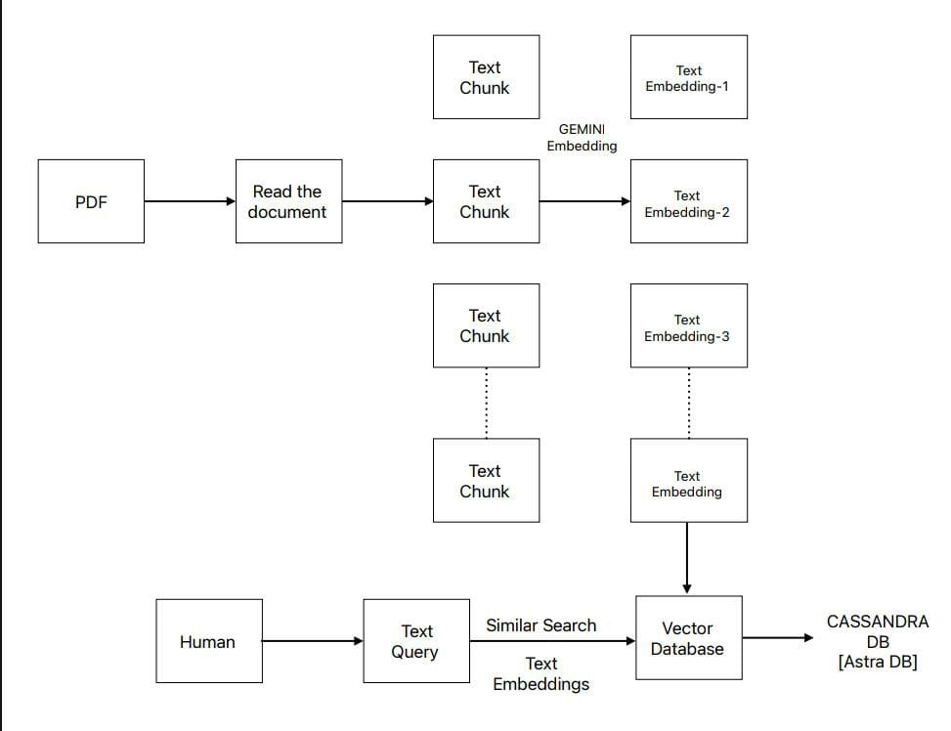
FLOWCHART

Slide 6
Methodology
Requirement Analysis:
Conducted thorough analysis to understand user needs for the PDF Document Q&A Assistant. Identified essential functionalities: document processing, question answering, and interactive chatbot.
Technology Selection:
Chose Streamlit for its simplicity and interactivity in building the user interface. Selected LangChain for text processing, Google AI for question answering (Gemini), and Groq for chatbot functionality. Utilized Cassandra as the backend database for storing documents and efficient query fetching.

Slide 7
System Design:
Designed system architecture to illustrate interactions between frontend, backend, and external services.
Developed a data pipeline for document processing, text extraction, and storage in Cassandra.
Integrated LangChain modules for text splitting, question answering, and chatbot interactions.
Implementation:
Implemented frontend components using Streamlit, including user interfaces and result visualization.
Developed backend services for document processing, text chunking, and Cassandra interaction. Integrated LangChain libraries for language processing tasks like question answering and chatbot interactions.

Slide 8
TECHNOLOGIES USED
Streamlit: Chosen for its simplicity and interactivity, Streamlit was utilized to develop the user interface, facilitating user input and result visualization.
LangChain: Integrated for text processing tasks, LangChain modules were employed for text splitting, question answering, and chatbot interactions.
Google AI (Gemini): Leveraged for question answering capabilities, Google AI was integrated to provide accurate responses to user queries.
Groq: Utilized for chatbot functionality, Groq enabled interactive communication and assistance within the application.
Cassandra: Employed as the backend database, Cassandra facilitated efficient storage and retrieval of PDF files, as well as query fetching, ensuring robustness and scalability.
Vector Database (VecTor): Utilized for similarity search, VecTor enabled efficient retrieval of relevant text chunks in response to user queries, enhancing the system's responsiveness.
DataStax: Integrated with AskQ DB for enhanced database management and query processing, DataStax contributed to the system's scalability and resilience.

Slide 9
CHALLENGES FACED
PDF Parsing Complexity: Handling the intricacies of parsing PDF documents, including diverse formats and structures, posed a significant challenge.
Integration of External APIs: Ensuring seamless integration with external APIs, such as language processing tools and chatbot frameworks, demanded careful coordination and compatibility testing.
Performance Optimization: Optimizing system performance for efficient document processing and real-time response times necessitated fine-tuning algorithms and resource allocation.
Data Consistency and Integrity: Maintaining data consistency and integrity across distributed databases, particularly in a dynamic environment, presented ongoing challenges.
User Interface Design: Designing an intuitive and user-friendly interface that accommodates diverse user needs and preferences required iterative design iterations and usability testing.
Scalability and Resource Management: Managing system scalability and resource allocation to accommodate growing user demands while maintaining performance and reliability posed ongoing challenges throughout the project lifecycle.

Slide 10

Conclusion:
Developed a Document Q&A Assistant integrating document processing, question answering, and chatbot functionalities.
Improved access to information within documents by providing a user-friendly interface for efficient retrieval.
Empowered users to extract knowledge from files seamlessly, enhancing their productivity.
Successfully deployed the solution, achieving the objective of streamlining document interaction.
Envisioned future enhancements to continue meeting evolving user needs and delivering innovative solutions.

Slide 11
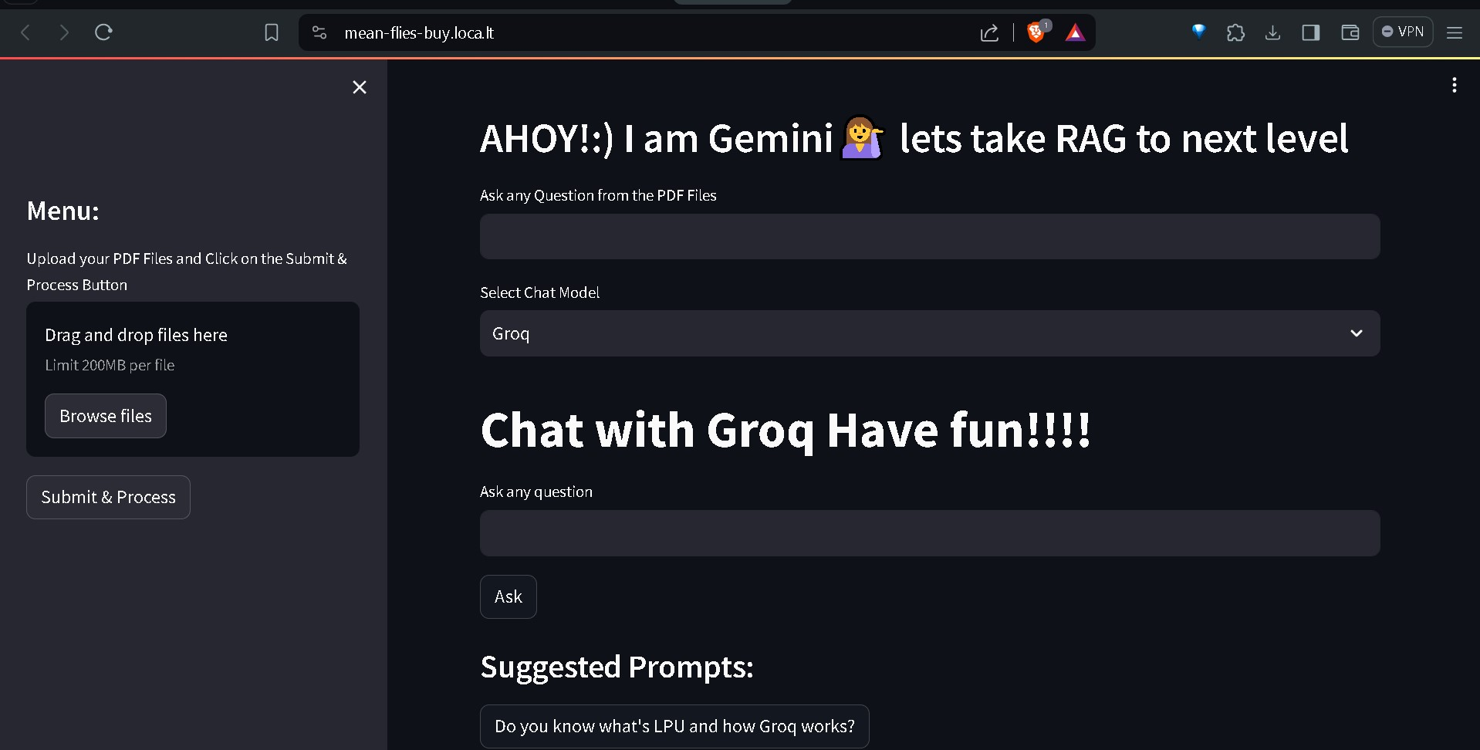
Streamlit Interface :
The Streamlit frontend offers a user-friendly interface with interactive inputs for queries and PDF uploads, real-time visualization of results, customizable layouts, responsive design for cross-device accessibility, robust error handling, seamless integration with other libraries, quick deployment capabilities, support for rich media types, and access to a supportive developer community for resources and assistance.

Slide 12
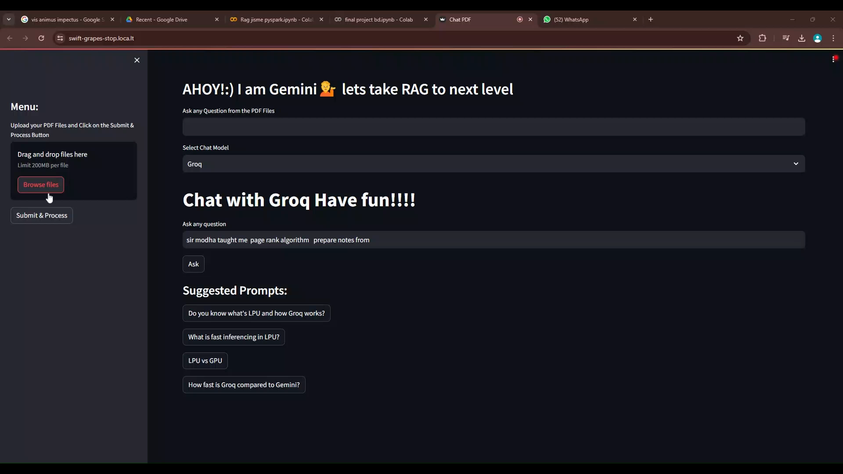
Video Demonstration

Slide 13
REFERENCES:
[1] Payal Bajaj, Daniel Campos, Nick Craswell, Li Deng, Jianfeng Gao, Xiaodong Liu, Rangan Majumder, Andrew McNamara, Bhaskar Mitra, Tri Nguyen, Mir Rosenberg, Xia Song, Alina Stoica, Saurabh Tiwary, and Tong Wang. MS MARCO: A Human Generated MAchine Reading COmprehension Dataset. arXiv:1611.09268 [cs], November 2016. URL http: //arxiv.org/abs/1611.09268. arXiv: 1611.09268.
[2] Petr Baudiš and Jan Šedivy. Modeling of the question answering task in the yodaqa system. In ` International Conference of the Cross-Language Evaluation Forum for European Languages, pages 222–228. Springer, 2015. URL https://link.springer.com/chapter/10.1007% 2F978-3-319-24027-5_20.
[3] Jonathan Berant, Andrew Chou, Roy Frostig, and Percy Liang. Semantic Parsing on Freebase from Question-Answer Pairs. In Proceedings of the 2013 Conference on Empirical Methods in Natural Language Processing, pages 1533–1544, Seattle, Washington, USA, October 2013. Association for Computational Linguistics. URL http://www.aclweb.org/anthology/ D13-1160.
[4] X. Cheng, D. Luo, X. Chen, L. Liu, D. Zhao, and R. Yan, “Lift yourself up: Retrieval-augmented text generation with self memory,” arXiv preprint arXiv:2305.02437, 2023.
[5]↑S. Wang, Y. Xu, Y. Fang, Y. Liu, S. Sun, R. Xu, C. Zhu, and M. Zeng, “Training data is more valuable than you think: A simple and effective method by retrieving from training data,” arXiv preprint arXiv:2203.08773, 2022.

Slide 14

Thank You!!

